Slide 1
Team Sorta Math Finance
Andrew Haskett, Katrina Hartley, Luke Nigro, Felipe Veloso
University of North Carolina at Charlotte

Slide 2
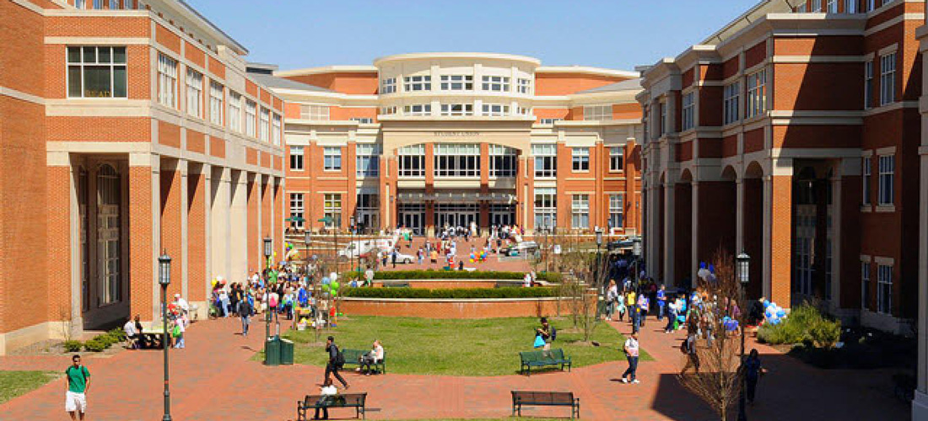
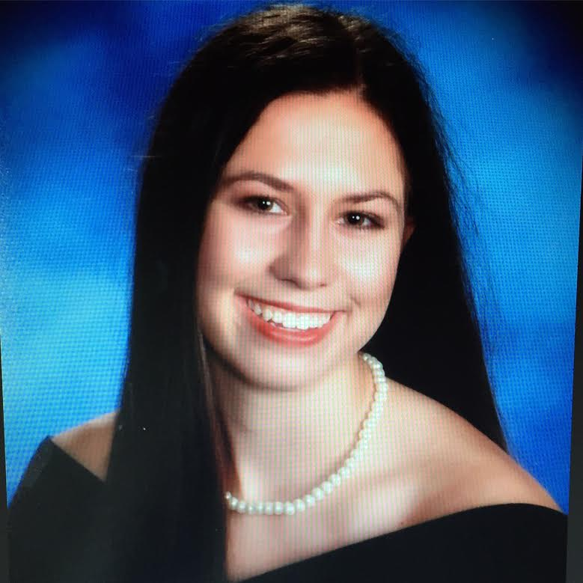
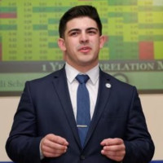
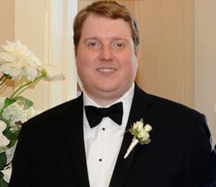

(Will get a legit group photo on campus when our schedules don’t collide)

Slide 3
Scope and Use Cases
Our group is aiming to maximize the quality of the Niner Rides Golf cart service. In order to achieve this, we will analyze golf cart metrics through the following Use Cases:
Track ride quality
Analyze the most popular locations
We are creating 8 normalized tables: Persons (breaking down into Students, Faculty, and staff tables), Cart, Location, Rides, Rating, and Payments with rating and payments weak entities to the Rides table. Through these tables, we’ll define set business requirements and schemas enabling us to join the necessary Golf cart data needed.

Slide 4
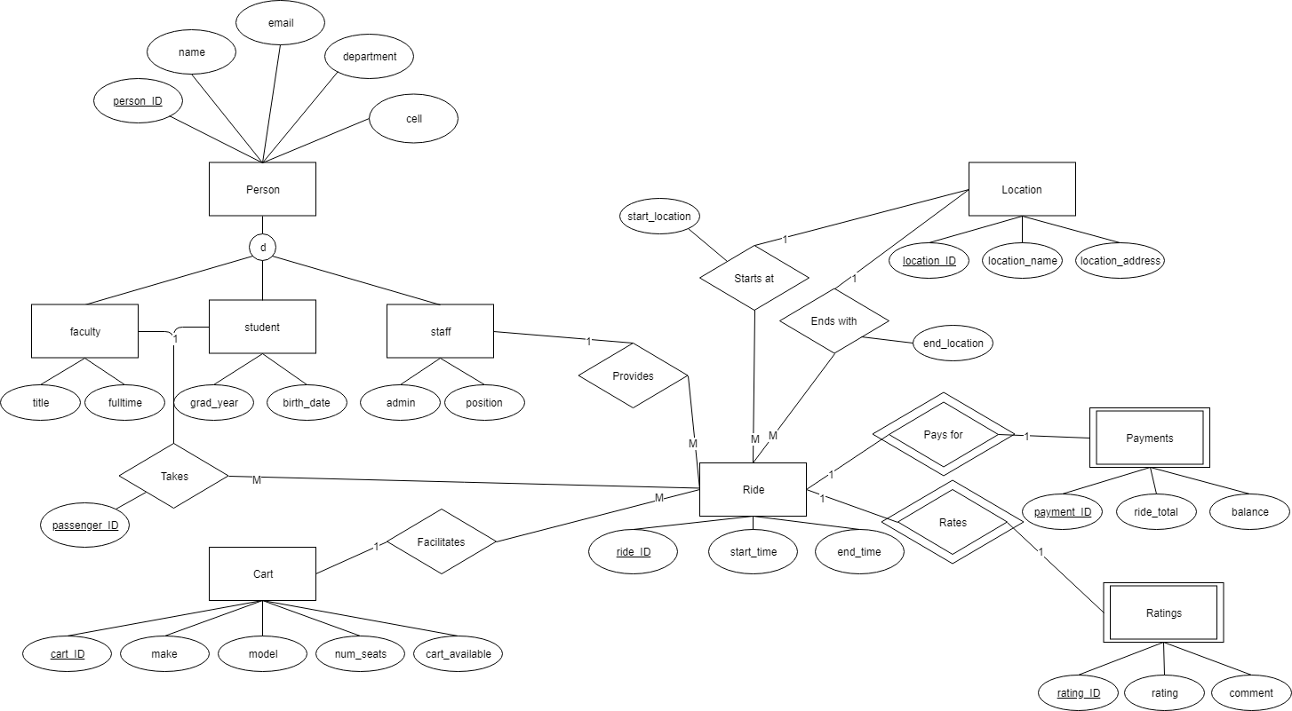
EERD Fully Normalized

Slide 5
Business Requirements (per entity)
Students: Can take a ride but can`t be a driver;
Faculty: Can take a ride but can`t be a driver;
Staff: Can be a driver but can`t be a passenger;
Drivers: All the drivers must be staff members, not all the staff members are drivers;
Carts: It is possible to add and remove carts from the list;
Rides: All the rides must be on the campus;
-Each ride must have one driver and at least one passenger;
-Each ride must have a payment ID;
-Each ride may have a rating ID (could be NULL)
-Each ride must have a max. of 2 passengers;
-Each ride must have a start and end points;
Ratings: The range will be from 1 to 5 (based on UBER);

